Slide 1
Findings in Visualization
The Dapper Squirrels

Slide 2
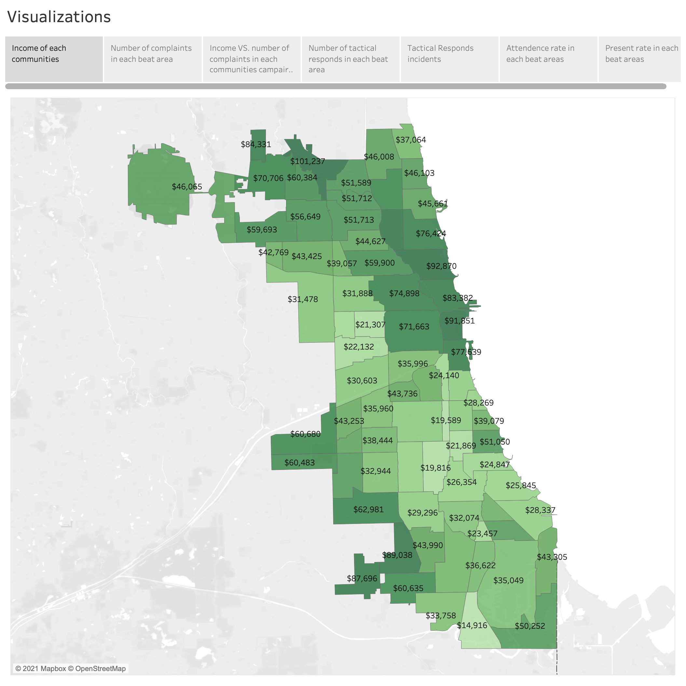
Visualizing something in the real world like a map is always attractive and easy to understand. So, we create an income map for all the areas in Chicago. Darker color means higher income in the region. This way, we can see the income level clearly in all areas, beats, and even streets. It also opens the door to a more thorough analysis of our analysis of income and community.
As we can see from the income map, areas with a similar level of income usually come from nearby areas. For example, high income in the northeast and southwest areas and low income in southeast areas. Also, different areas are drastically varied in their median income. The largest number gets as high as 100k, but the lowest number can be only over 10k. Typically, lower-income means more crimes in the area. When there are much more crimes in any area, there must be more possibility of over-policing. Furthermore, we can find out more details by correlating the income map with over-policing. So, we created the complaint rate map in the following analysis, which indicates direct correlations with low income as expected.

Slide 3
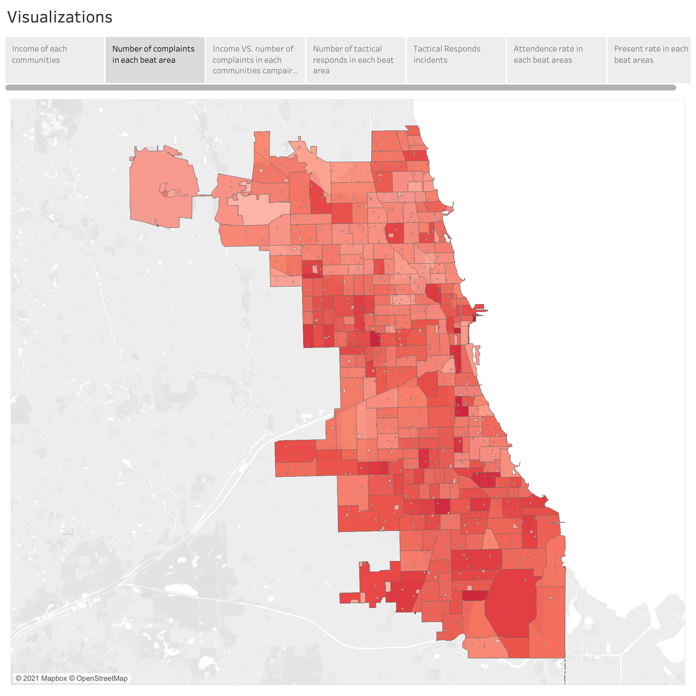
To investigate the relationship between complaint rate and locations, we made a heat map with the number of complaints in each beat area. We can see from the map that different geolocations have a totally different complaint rate and they typically come together in large areas. For example, in northwest and south areas of Chicago, there is a high complaint rate.

Slide 4
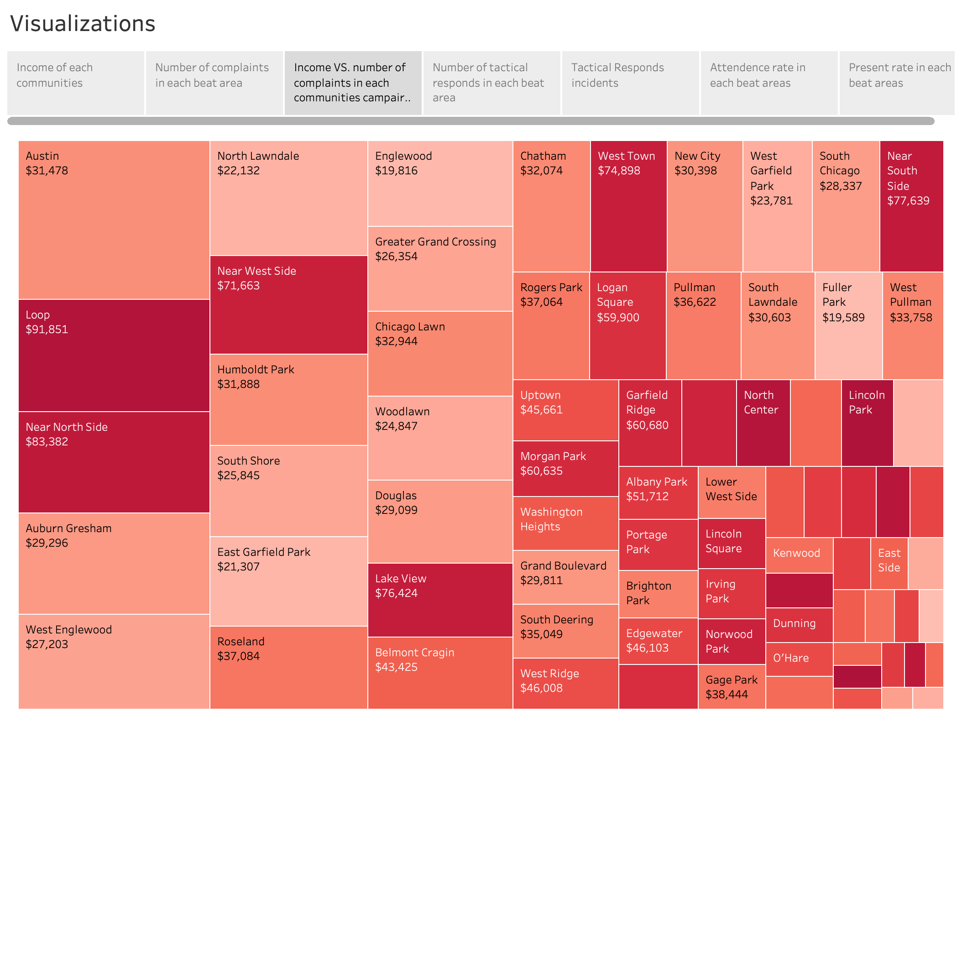
To make the observation clear, we also created a plot for the number of complaints in comparison with income levels in each community. This plot is designed to show that higher-income communities would bring deeper color to tiles, and more complaints would make the tile bigger. We found that most of the high income areas come with smaller tiles, although there are outliers like Loop and Near North Side. Overall, it conforms with our prior hypothesis that income level is negatively associated with complaint rate.

Slide 5
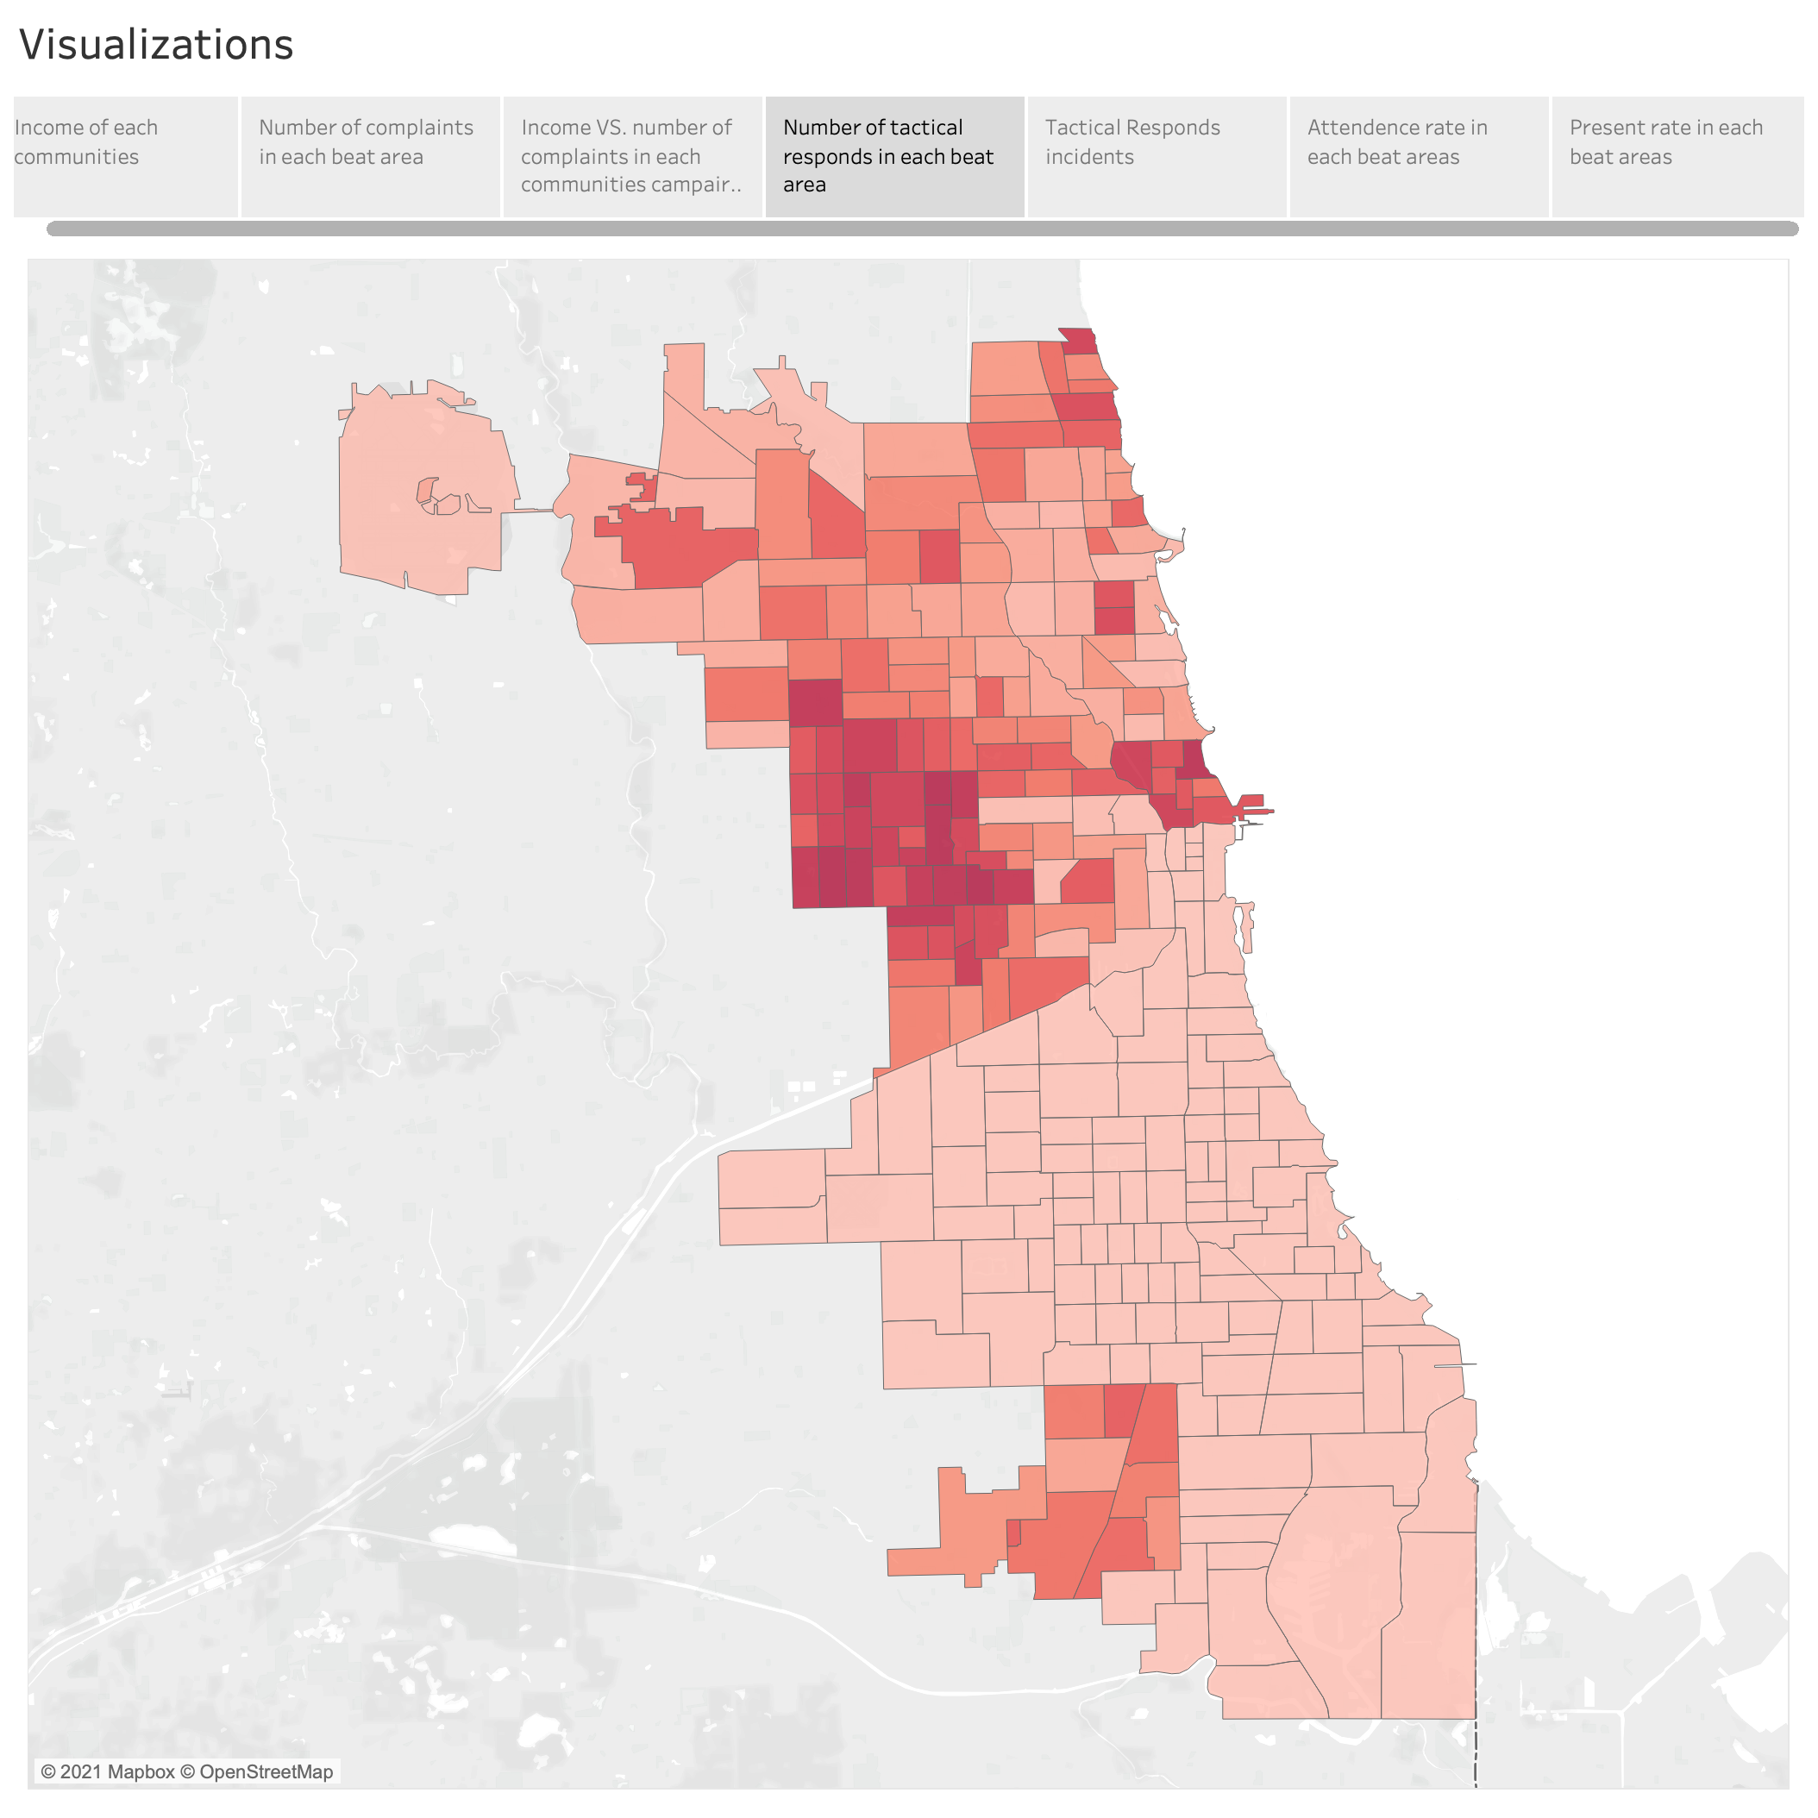
We believe complaint rate in each area is positively related to the rate of over-policing. Based on this hypothesis, we need to investigate the relationship between locations, income, and complaint rate. So, we calculated the count of tactical responds in each area and every over-policing incident that happened in the past as a dot on the map(the next page). Combining this complaint rate map and the previous income map, we can see high complaint rate in the low-income area. For example, in northeastern Chicago, a high-income area has the relatively lowest tactical respond rate. In conclusion, if complaint rate is positively related to over-policing, we can say low-income is related to high rate of over-policing.

Slide 6
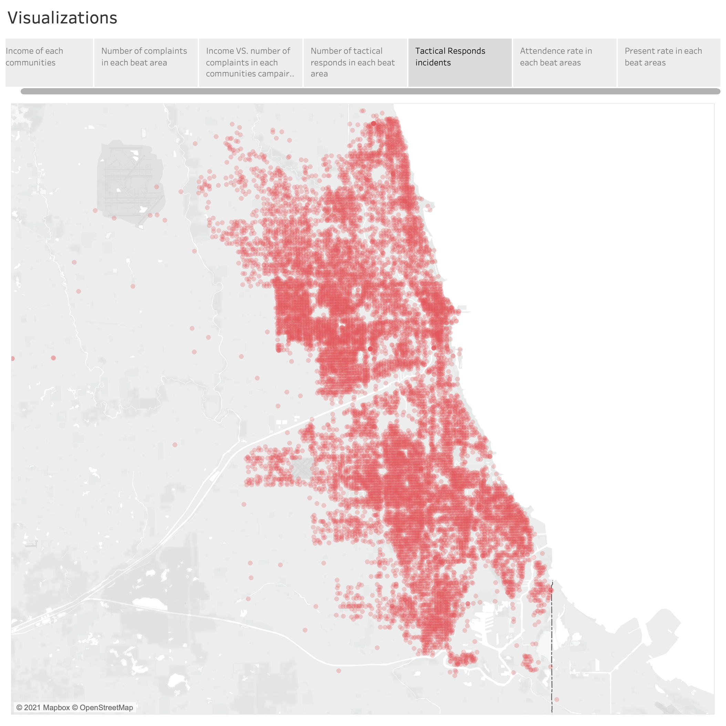

Slide 7
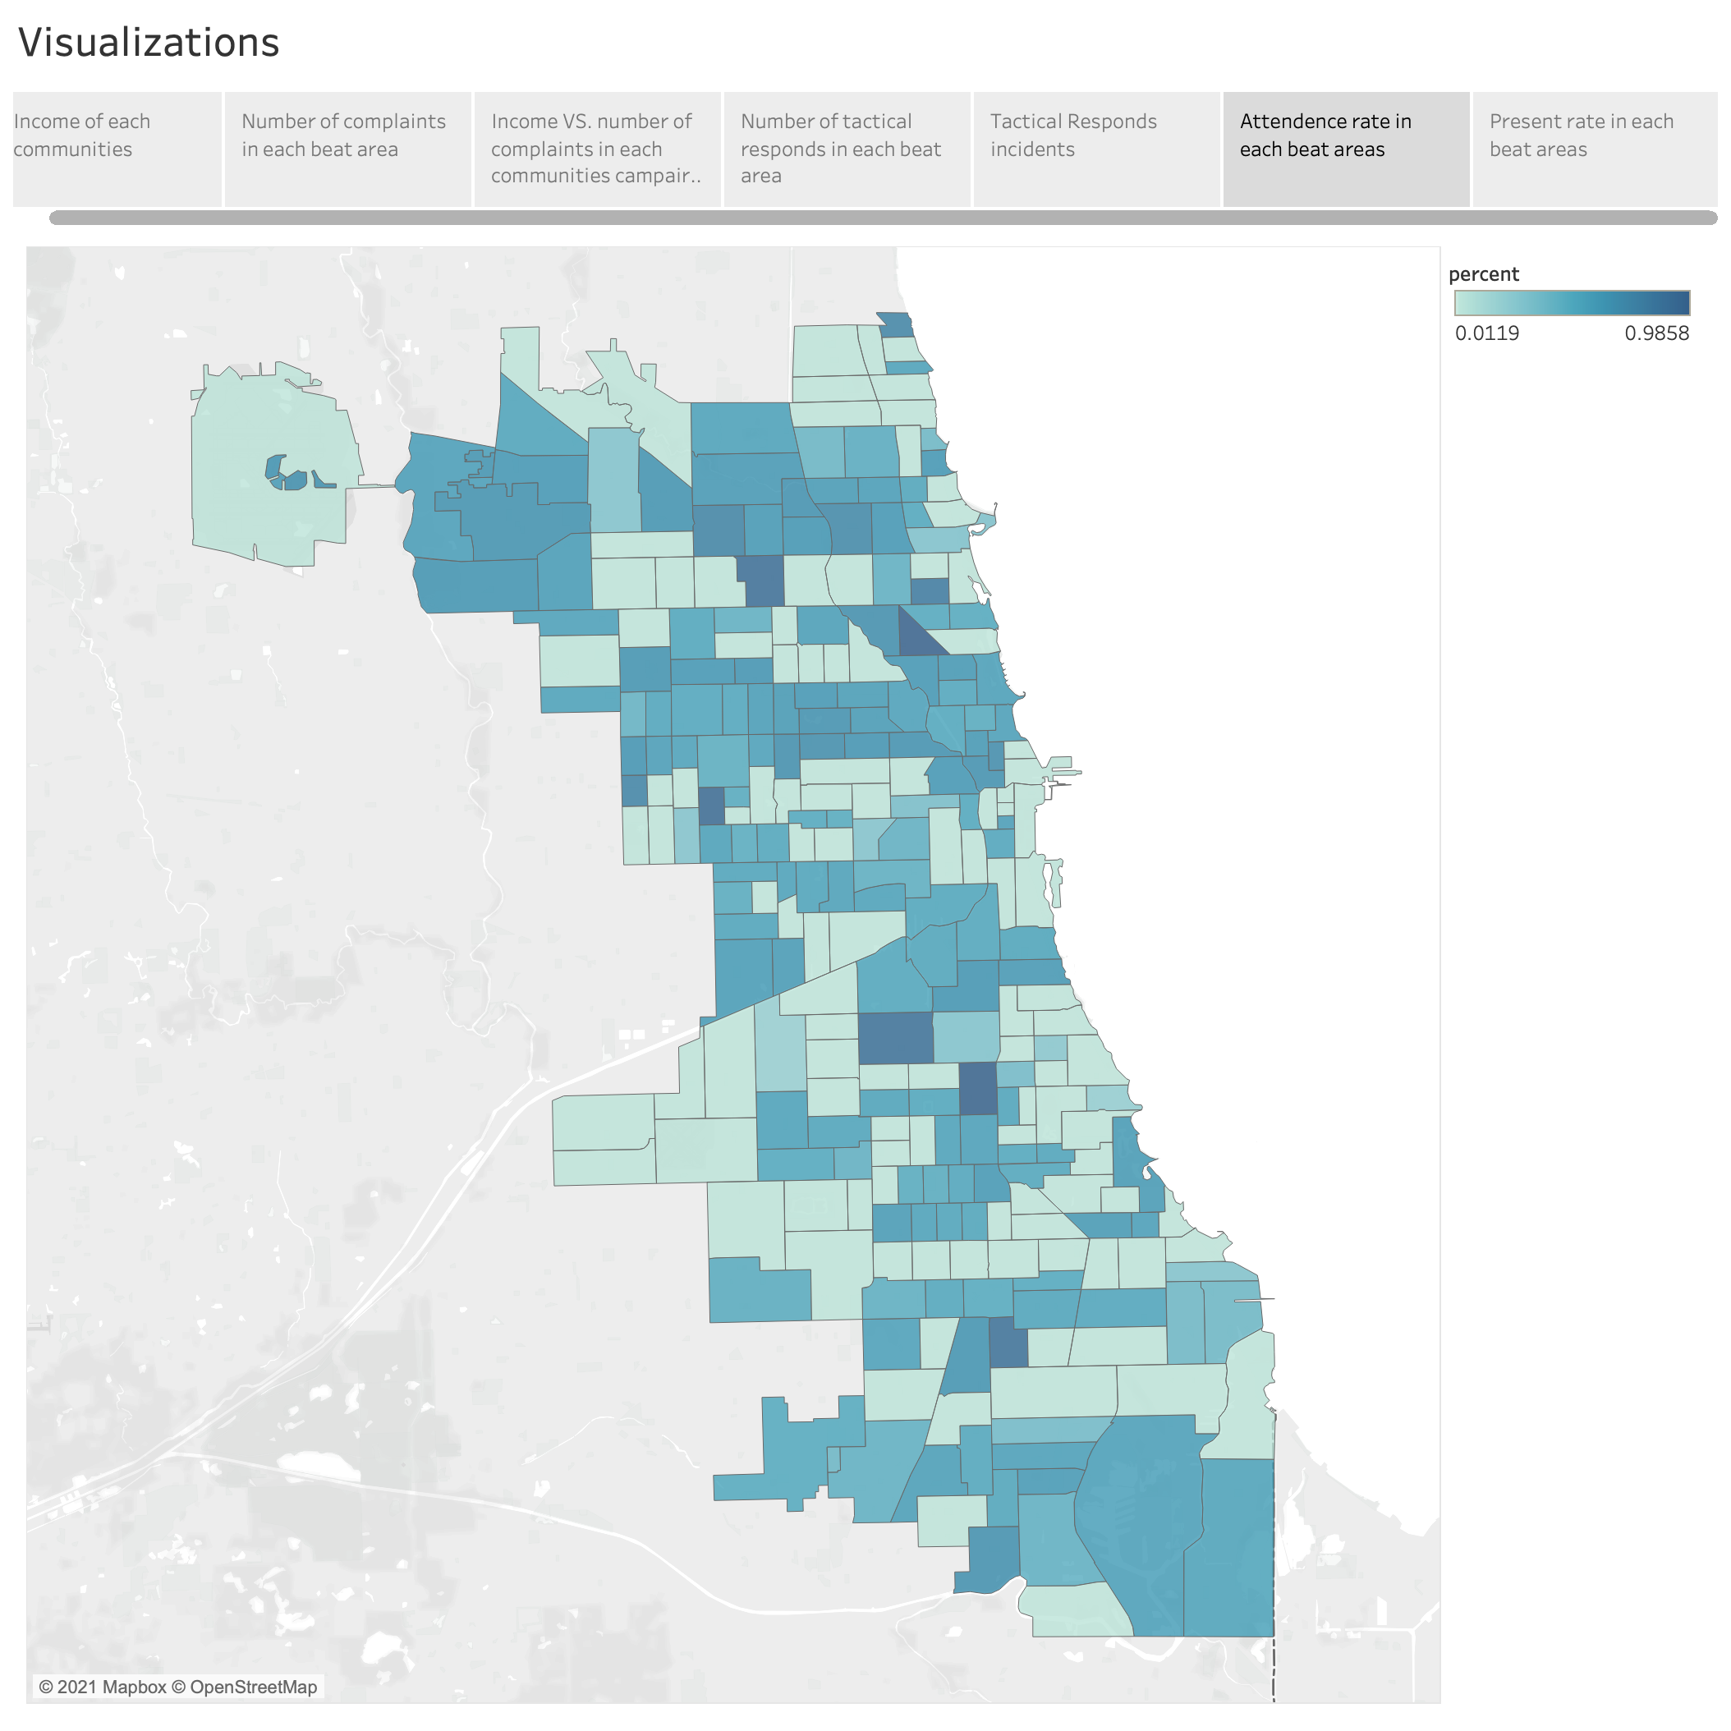
In our proposal, we planned to generate a heat map of the officer hour in different areas. However, there is no information about officer hours associated with the area. We would like to have such a map since if a place has significantly high officer hours mean police are focusing on such area and they may use over-policing to ensure security in that area.
To achieve the same goal, we believe the heat of attendance rate associated with beat id can have the same function. We will analyze the reason in the following discussion.
(see next page)

Slide 8
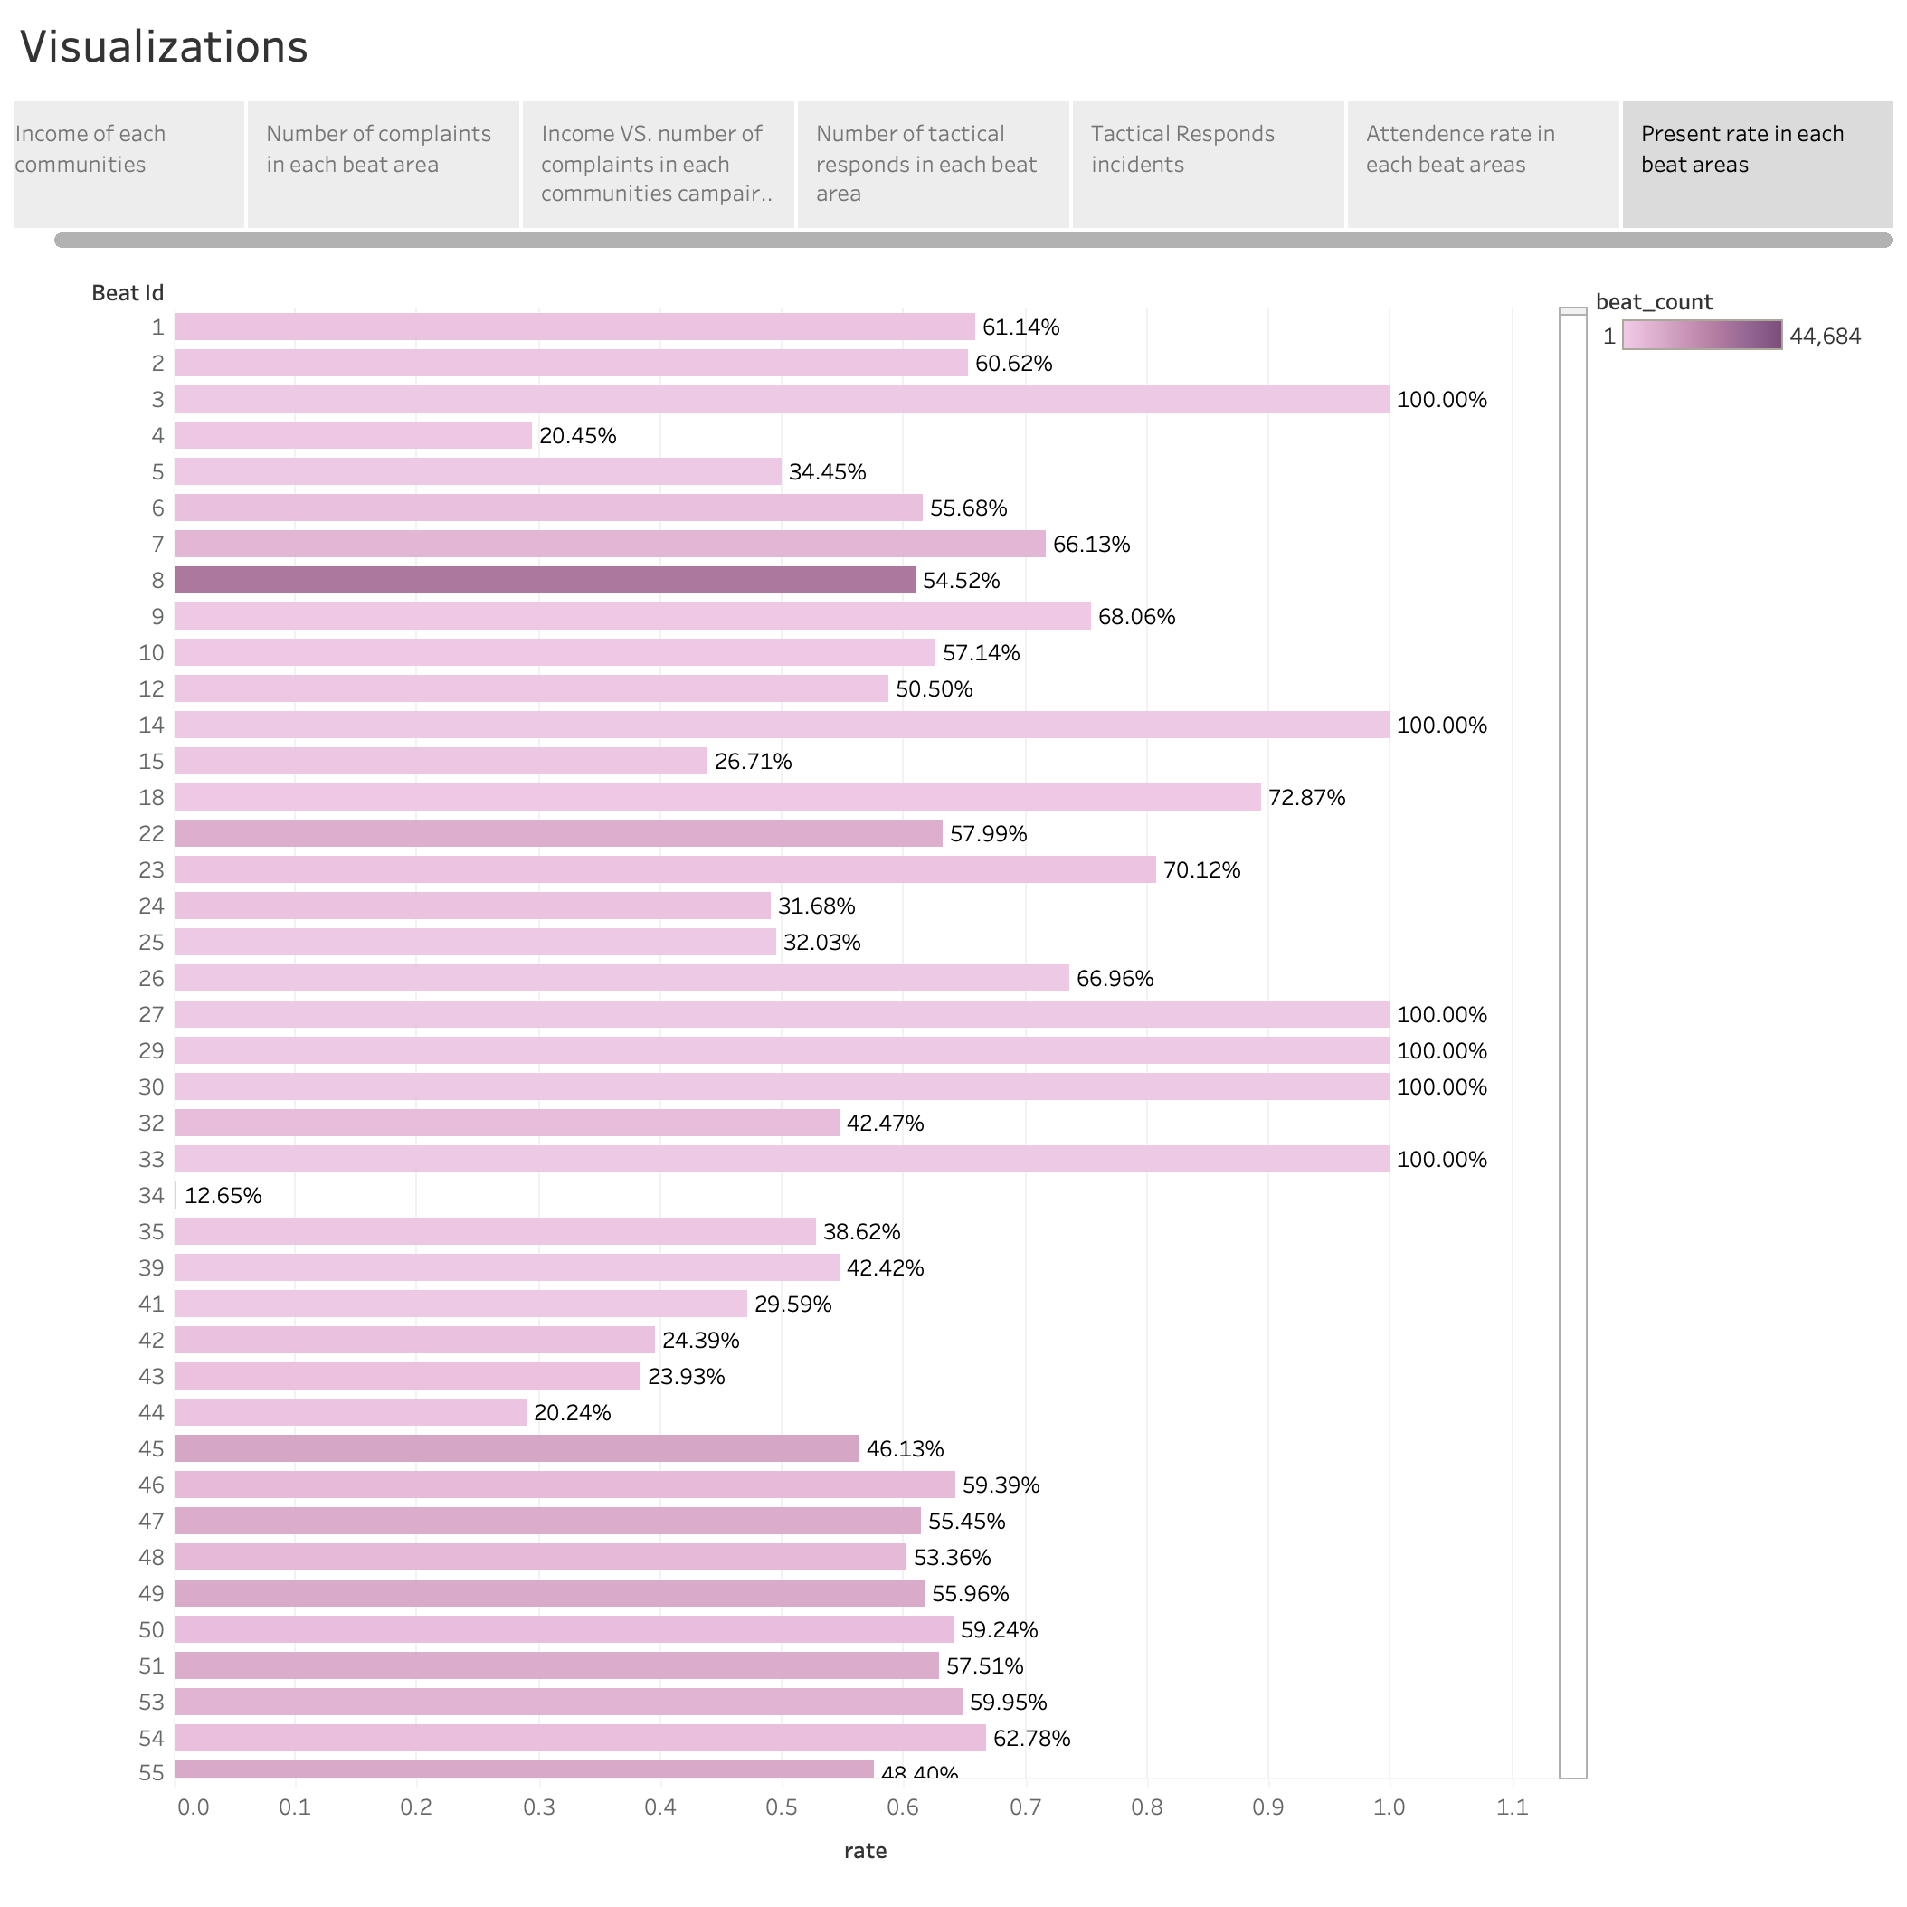
(following the previous page)
From the previous parts, we learned the relationship between income and the CRs or TRRs. But should we think about one question first, did every police officer goes to duty in every beat? There is a possibility that the low CRs and TRRs from the area are caused by low attendance.
This figure shows the percentage of attendances in different beats. For example, we put our view on the south area. The attendance rate in some low-income areas is near 90%. This is good, since officers here are willing to work, if there is no evidence of over-policing, then there is not.
However, there is some low-income place that has low attendance rate. If we also find there has a high volume of CRs, we should consider there is potential over-policing.

